Slide 1
InDez -An augmented reality-based application

Slide 2



Supervised By:
Dr. Ahmedul Kabir
Assistant Professor
Submitted By:
Mehedi Hasan Sun(BSSE1025)
Abdullah-Al-Jahid(BSSE1030)

Slide 3
01
Introduction

Slide 4
Introduction
This is an augmented reality-based android application that will be used for interior designing and decorating. Our application will provide users the option to drag and drop augmented furniture in their room which they are able to see using their phone’s camera. Then users can select the color and texture of furniture and wall, change room lighting.

Slide 5
02
Before InDez

Slide 6


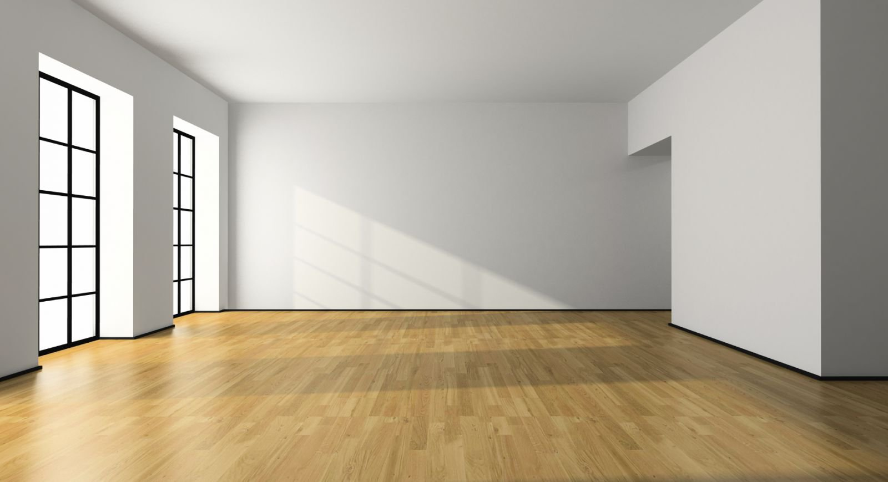
Where to place my furniture?

Slide 7
03
After InDez

Slide 8
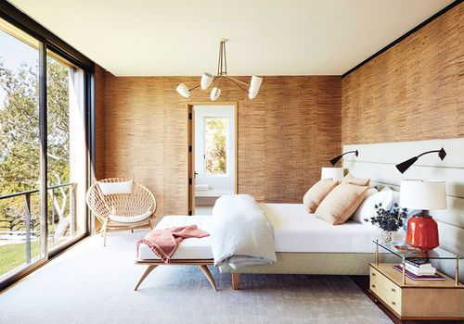


Slide 9
04
Scope of the Project

Slide 10
Features
Users can drag and drop augmented furniture in their room which will be able to see using phones camera
Users can change the position of the furniture
Users can change the size of the furniture
Users can change the color of the furniture
Users can change the color of the walls and the
floor

Slide 11
05
Motivation

Slide 12
Motivation
Furniture placement in the room can be a very confusing task.
One can hire interior designers.
Visit the house and make a plan .
Don’t look exactly the same as what their designer has explained.
Sometimes designers have to change their plan.
Most people can’t hire designers.

Slide 13
06
Work Plan

Slide 14
1-3
3-5
4-7
Work Plan
Apply Ground Plane Detection in our project
3-8
Add transitioning , scaling, rotating characteristics
7-10
11-14
Add color and texture edition features
Analyzing and Specifying ideas
Learn Unity and C#
Prepare SRS Report
15-16
Test and fix bug

Slide 15

Thank You

